Slide 1
Modeling Transformations
2D Transformations
Amartya Kundu
Lecturer, CSE, UGV

Slide 2
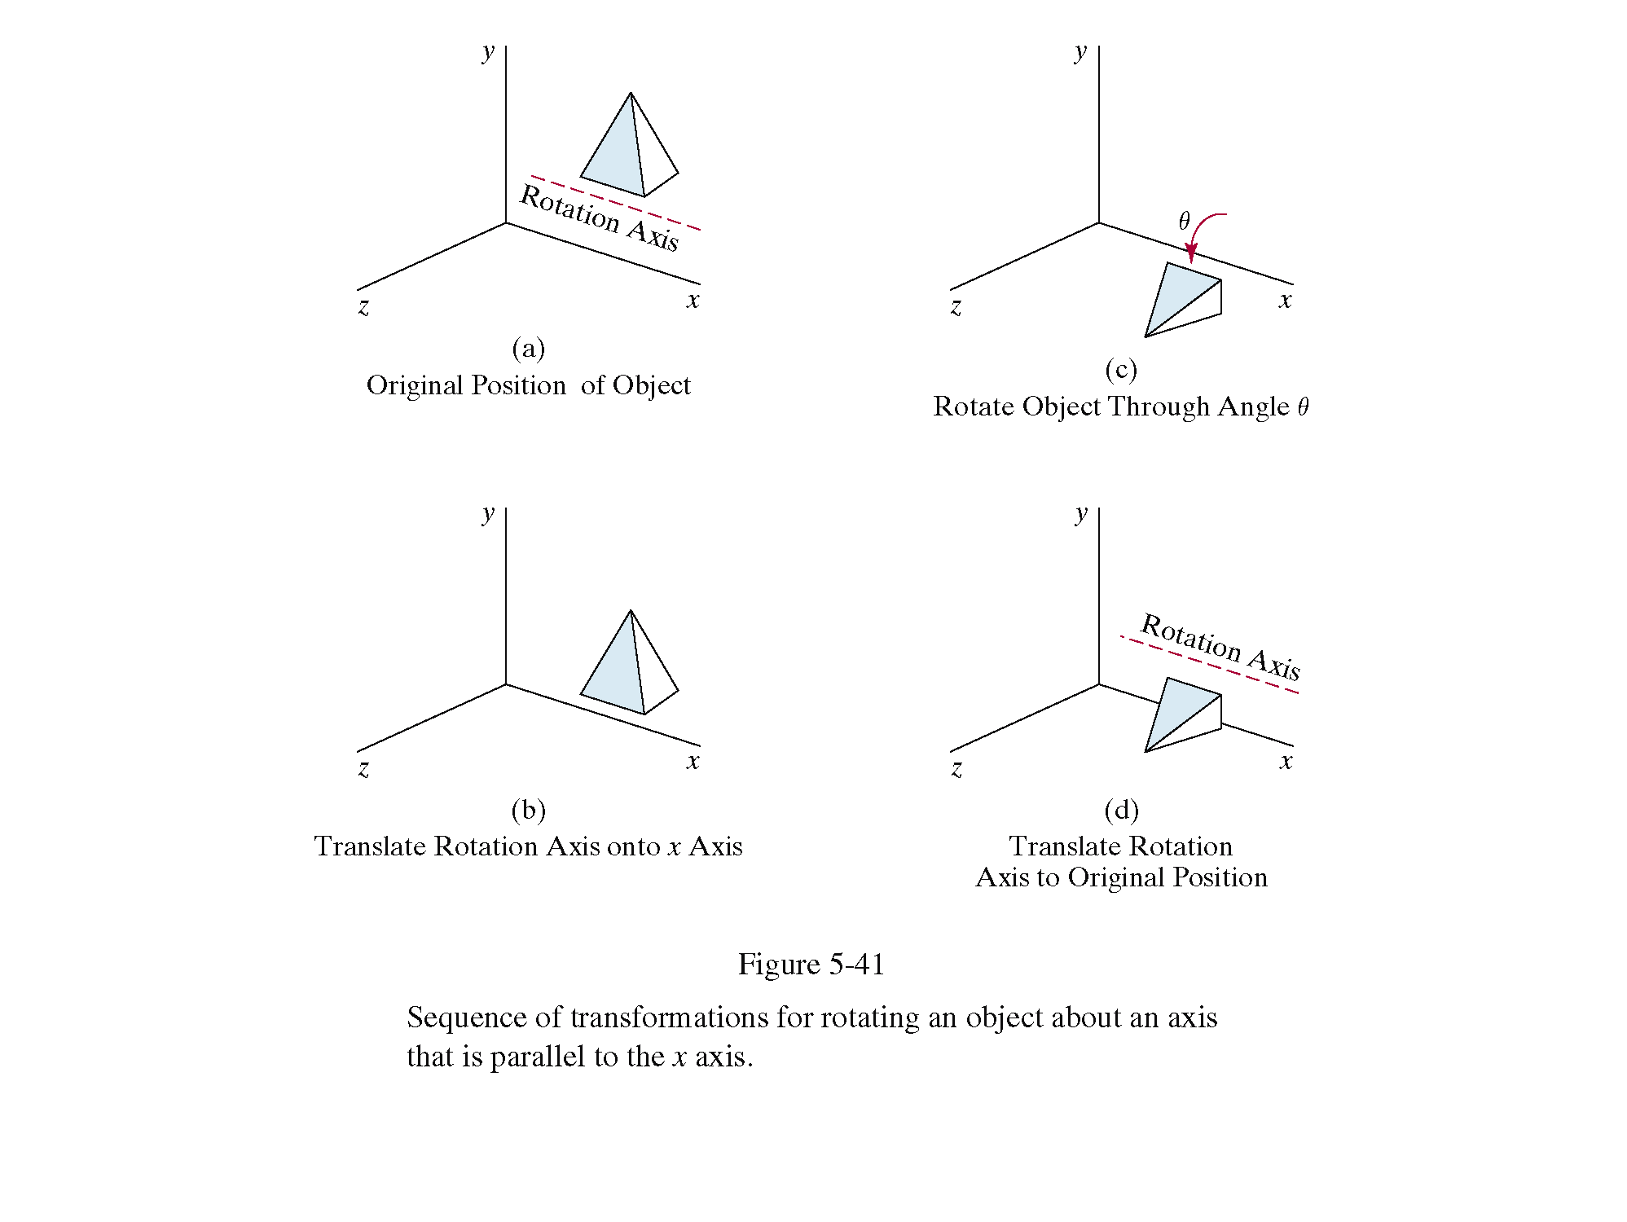
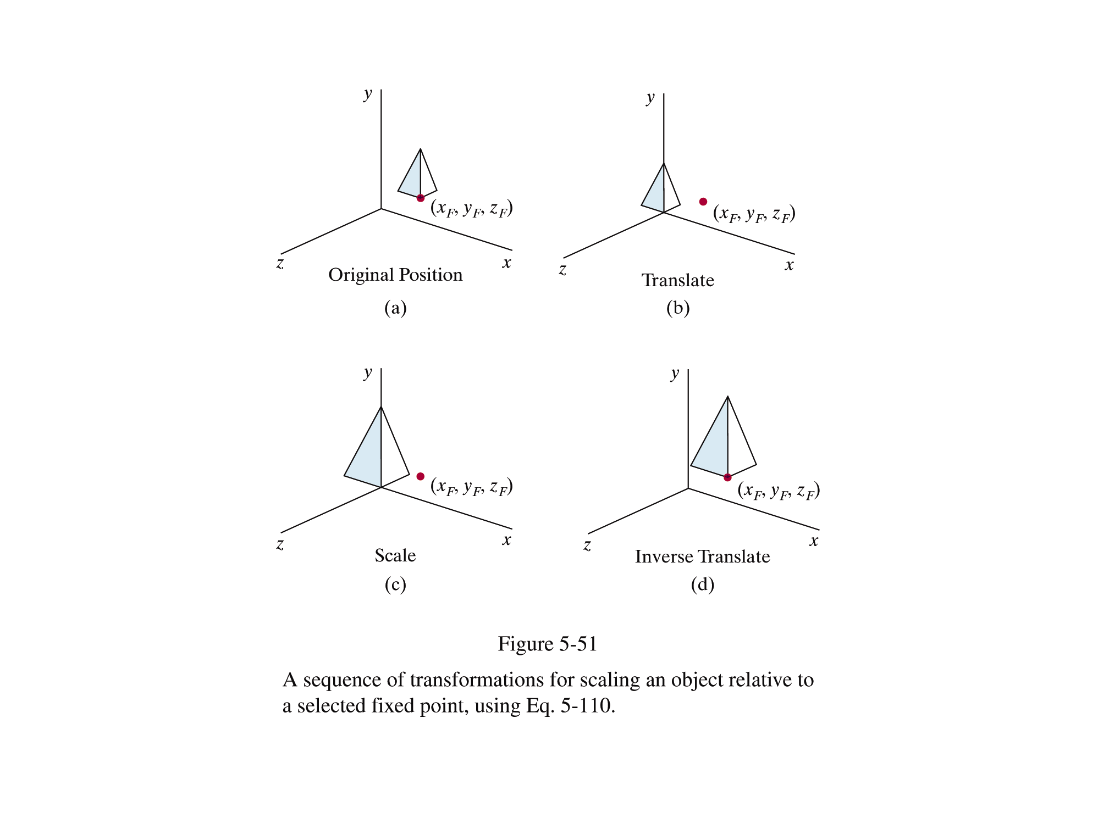

Why Transformations?
In graphics, once we have an object described, transformations are used to move that object, scale it and rotate it
Images taken from Hearn & Baker, “Computer Graphics with OpenGL” (2004)

Slide 3
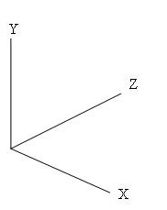

Use of Transformations
Modeling
  Build complex models by positioning simple components
  Transform from object coordinates to world coordinates
Viewing
  Placing the virtual camera in the world
  Specifying transformation from world to camera coordinates
Animation
  Vary transformations over time to create motion
y
x
z
z
x
camera
y
object
world

Slide 4
Modeling Transformations
~ places the objects defined by their own coordinate system into a common scene of world coordinate system.
Moving or transforming an object can be achieved by
  Geometric transformation – changes in orientation, size and shape of objects are accomplished by altering coordinate description of objects.
  Coordinate Transformation – same effect is attained by holding the object stationary while coordinate system is transformed relative to object.

Slide 5
Modeling Transformations
We will go with Geometric transformation
  Basic Transformations
    Translation
    Rotation
    Scaling
  Some else are
    Shear
    Mirror reflection
  Homogeneous coordinate system
  Composition of transformations

Slide 6
Translation
Simply moves an object from one position to another
  Object is displaced a given distance and direction
x_{new} = x_{old} + dx y_{new} = y_{old} + dy
y
6
5
4
3
2
1
0
1
2
3
4
5
6
7
8
9
10
x
Note: House shifts position relative to origin

Slide 7
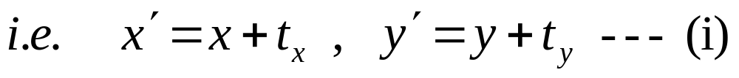
Translation – 2D
If displacement is the vector V = t_{x}I + t_{y}J, new point P′(x′,y′) can be found by adding translation distance (t_{x},t_{y}) to the old point P(x,y)
Representing the points and displacement as a column vector
⎡
x
⎤
⎡
x
′
⎤
⎡
t
⎤
P
=
⎢
⎥
P
′
=
⎢
⎥
T
=
⎢
x
⎥
P’
⎣
y
⎦
⎣
y
′
⎦
⎣
t
⎦
y
P
Eq. (i) becomes
P
′
=
P
+
T

Slide 8

Rotation
Rotates all coordinates by a specified angle
x_{new} = x_{old} × cosθ – y_{old} × sinθ
y_{new} = x_{old} × sinθ + y_{old} × cosθ
Points are always rotated about the origin
y
6
5
4
3
2
1
0
x
1
2
3
4
5
6
7
8
9
10

Slide 9
Rotation – 2D
In 2d rotation, object is repositioned along a circular path in xy plane.
  Rotates all coordinates by a specified angle
For rotation we specify
  Rotation angle (θ)
    Counter clockwise – positive angle
    Clockwise – negative angle
  Pivot point (x_{r},y_{r}) – center of rotation
What is the transformation eqn?
y
6
5
4
3
2
1
0
x
1
2
3
4
5
6
7
8
9
10

Slide 10
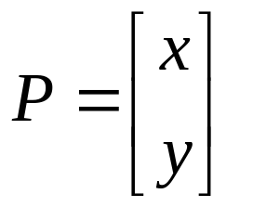
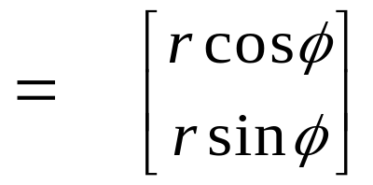
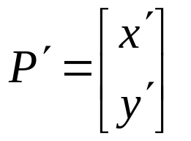
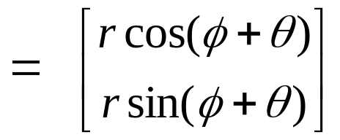
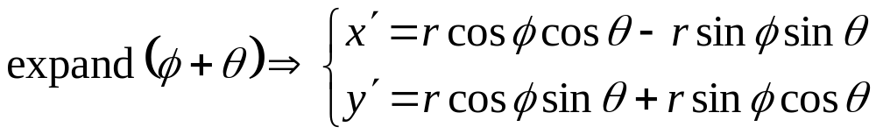
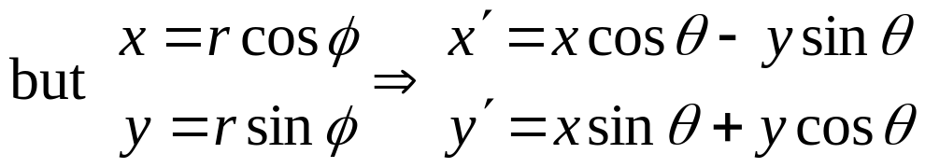
Rotation – 2D, origin as pivot point
y
θ
P′
r sin(φ +θ )
r
P
r sinφ
θ
r
φ
r cos(φ + θ )
x
r cosφ

Slide 11
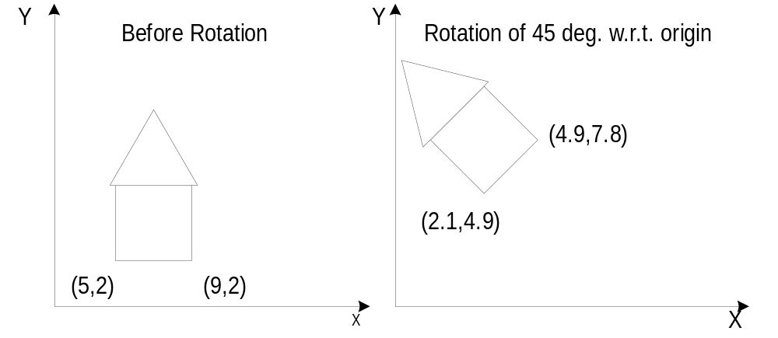
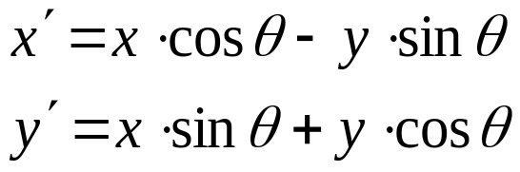
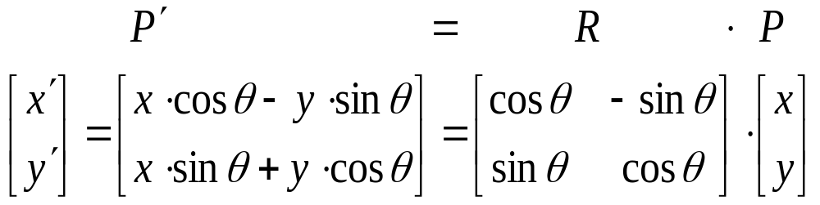
Rotation – 2D
This eq can be represented in matrix form as -

Slide 12
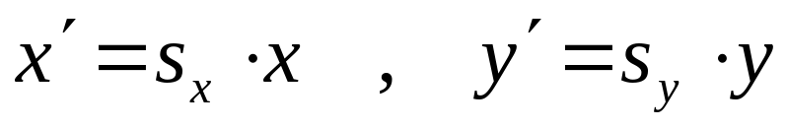
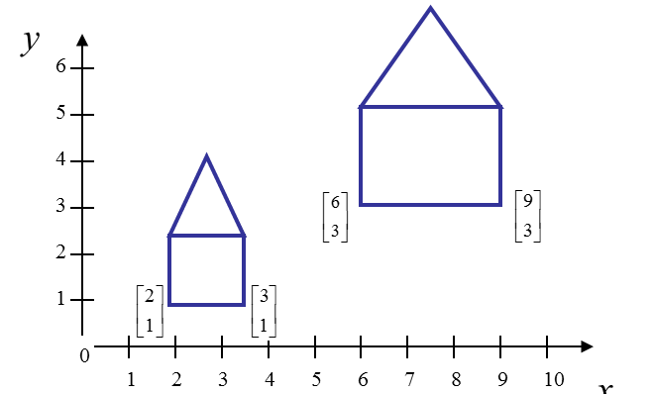
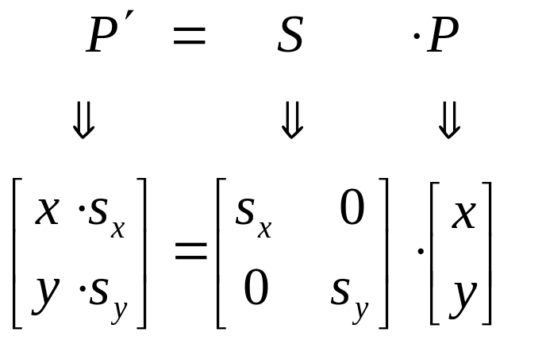
Scaling – 2D
Scaling alters the size of an object
Transformed coordinates P′(x′, y′) are found by multiplying the coordinate values P(x, y) of each vertex of object by scaling factor s_{x} and s_{y}.
ie.
In matrix form
WATCH OUT: Objects grow and move!

Slide 13
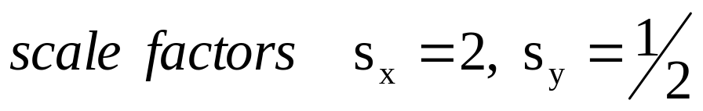
Scaling – 2D
Types of Scaling:
  Differential ( s_{x} != s_{y} )
  Uniform (s_{x} = s_{y} )
After scaling, new object is located at a different position relative to origin

Slide 14
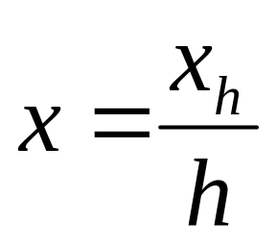
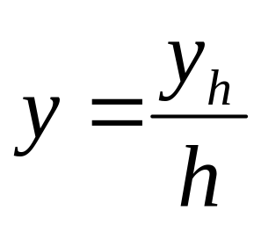
Homogeneous Coordinates
A point (x, y) can be re-written in homogeneous coordinates as (x_{h}, y_{h}, h)
The homogeneous parameter h is a non-
zero value such that:
We can then write any point (x, y) as (h_{x}, h_{y}, h)
We can conveniently choose h = 1 so that
(x, y) becomes (x, y, 1)

Slide 15
Why Homogeneous Coordinates?
Mathematicians commonly use homogeneous coordinates as they allow scaling factors to be removed from equations
Translation, scaling and rotation are expressed (non-homogeneously) as:
  translation: P′ = P + T
  Scale: P′ = S · P
  Rotate: P′ = R · P
Composition is difficult to express, since translation not expressed as a matrix multiplication
Using homogeneous coordinates allows us use matrix multiplication to calculate transformations – extremely efficient!

Slide 16
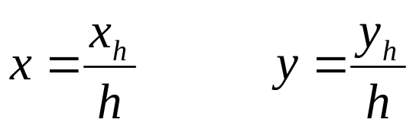
Homogeneous Co-ordinates
Translation, scaling and rotation are expressed (non-homogeneously) as:
  translation: P′ = P + T
  Scale: P′ = S · P
  Rotate: P′ = R · P
Composition is difficult to express, since translation not expressed as a matrix multiplication
Homogeneous coordinates allow all three to be expressed homogeneously, using multiplication of 3×3 matrices
Each Cartesian position (x,y) is represented by a triple (x_{h}, y_{h}, h), where,

Slide 17
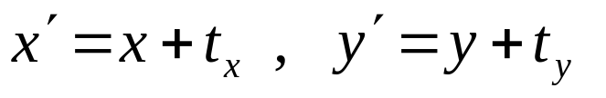
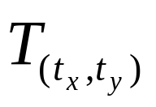
Homogeneous Co-ordinates
h can have any non zero value
So an infinite number of points correspond to (x,y)
Better to use h = 1
Point representation in ~ system allows all transformation eq as matrix multiplication, and
Transformation matrices are
  For translation
⎡
x
′
⎤
⎡
1
0
t
⎤
⎡
x
⎤
⎢
⎥
⎢
x
⎥
⎢
⎥
y
′
=
0
1
t
*
y
⎢
⎥
⎢
y
⎥
⎢
⎥
⎢
1
⎥
⎢
0
0
1
⎥
⎢
1
⎥
⎣
⎦
⎣
⎦
⎣
⎦

Slide 18

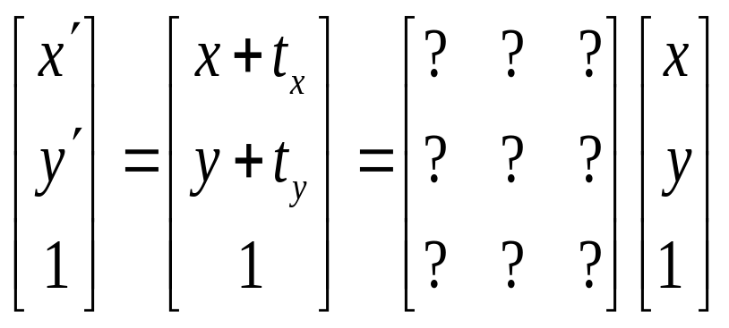
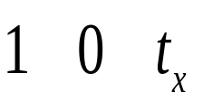
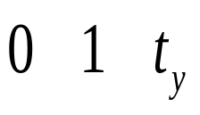

Homogeneous Translation
Representing the point as a homogeneous column vector
  The translation of a point by (t_{x}, t_{y}) can be written in matrix form as:

Slide 19
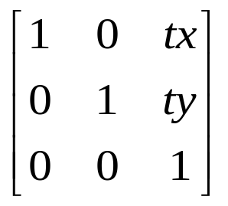
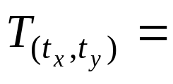
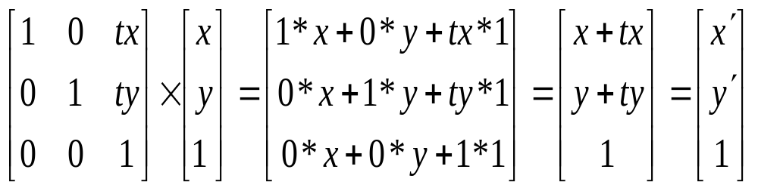
Homogeneous Translation
The translation of a point by (tx, ty) can be written in matrix form as:
Representing the point as a homogeneous column vector we perform the calculation as:
i.e.

Slide 20
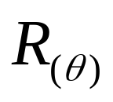
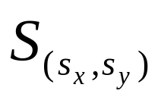
Homogeneous Co-ordinates
  For rotation
  For Scaling
⎡
x
′
⎤
⎡
cos
θ
−
sin
θ
0
⎤
⎡
x
⎤
⎢
′
⎥
=
⎢
θ
θ
⎥
⎢
⎥
⎢
y
⎥
⎢
sin
cos
0
⎥
*
⎢
y
⎥
⎢
1
⎥
⎢
0
0
1
⎥
⎢
1
⎥
⎣
⎦
⎣
⎦
⎣
⎦
⎡
x
′
⎤
⎡
s
0
0
⎤
⎡
x
⎤
⎢
⎥
⎢
x
⎥
⎢
⎥
y
′
=
0
s
0
*
y
⎢
⎥
⎢
x
⎥
⎢
⎥
⎢
1
⎥
⎢
0
0
1
⎥
⎢
1
⎥
⎣
⎦
⎣
⎦
⎣
⎦

Slide 21
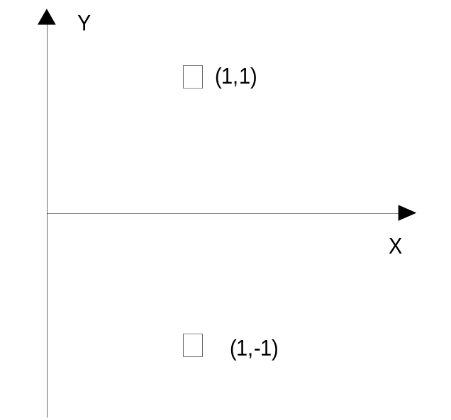
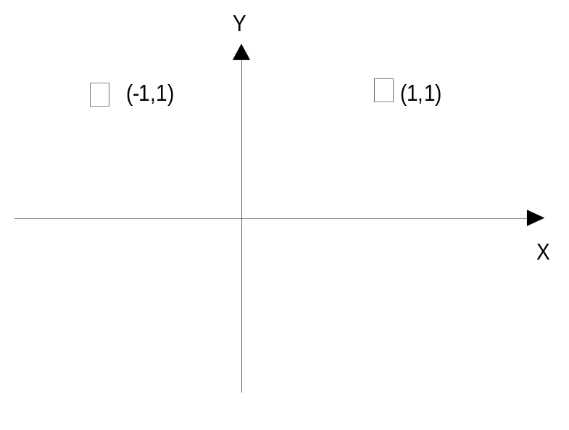
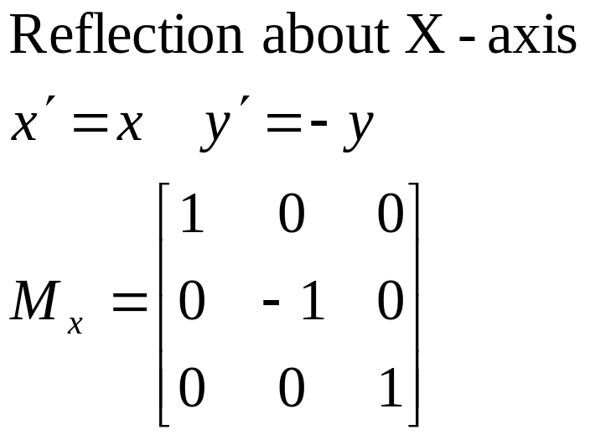
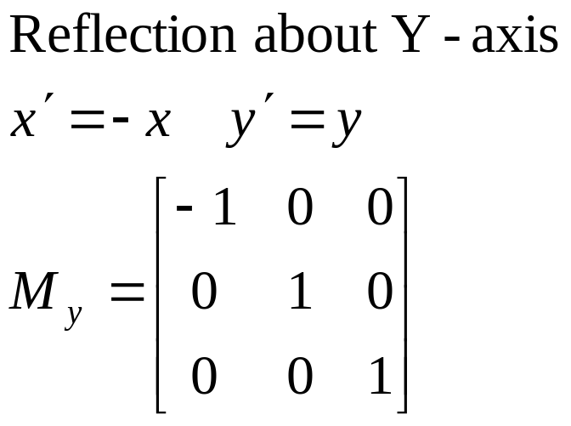
Mirror Reflection

Slide 22
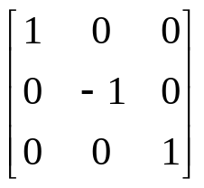
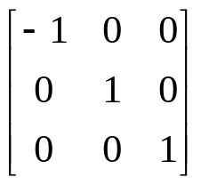
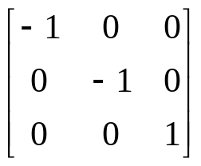
Reflection
Reflection with respect to the axis
1
1
1’
y
y
y
1’
2
3
2
3
3’
2’
3’
2’
x
x
3
x
2’
3’
2
1’
1
About x axis
About y axis
About origin

Slide 23
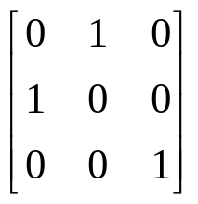
Reflection
Reflection with respect to a Line
Clockwise rotation of 45 → Reflection about the x axis → Counterclockwise rotation of 45
y
x
y=x 에 대한 반사
y
y
1
y
2
3
x
2’
3’
x
x
1’

Slide 24
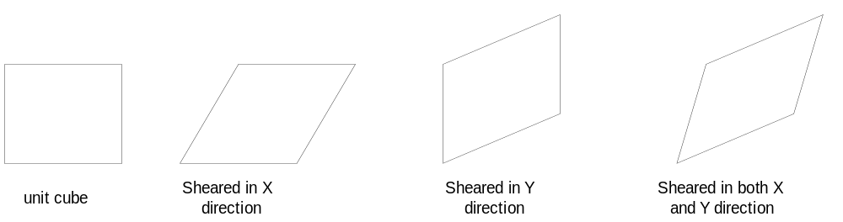
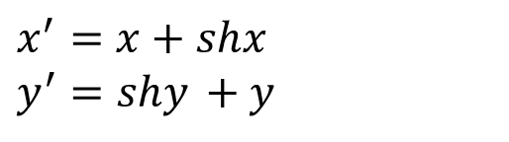
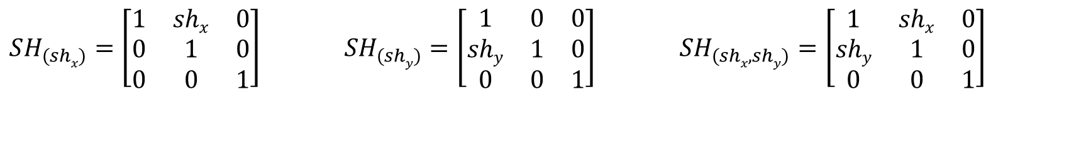
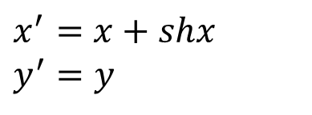
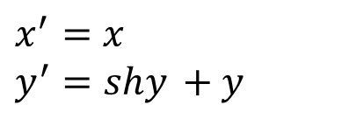
Shearing Transformation
$$x^{′}=x+shx \\ y^{′}=y$$
$$x^{′}=x \\ y^{′}=shy +y$$
$$x^{′}=x+shx \\ y^{′}=shy +y$$
$$SH_{(shx)}=\left[\begin{matrix}1 & shx & 0 \\ 0 & 1 & 0 \\ 0 & 0 & 1\end{matrix}\right] SH_{(shy)}=\left[\begin{matrix}1 & 0 & 0 \\ shy & 1 & 0 \\ 0 & 0 & 1\end{matrix}\right] SH_{(shx,shy)}=\left[\begin{matrix}1 & shx & 0 \\ shy & 1 & 0 \\ 0 & 0 & 1\end{matrix}\right]$$

Slide 25
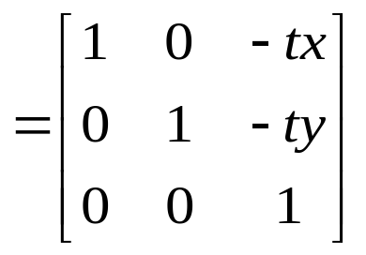
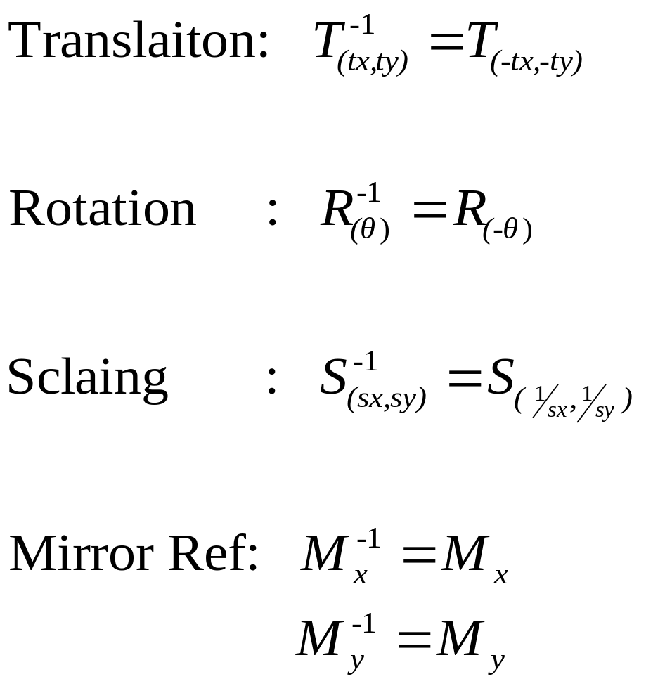
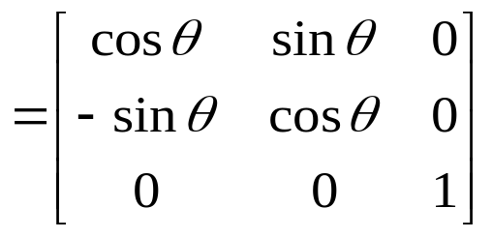
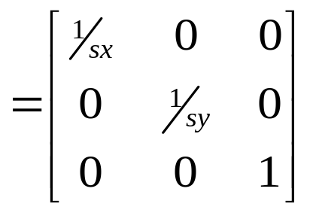
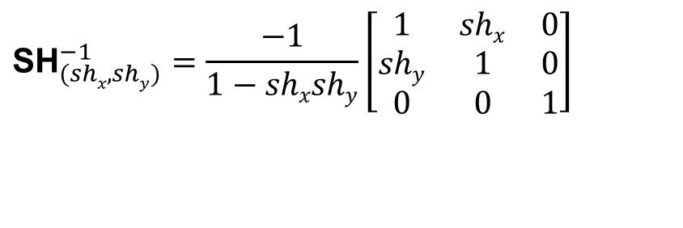
Inverse 2D - Transformations
Transformations can easily be reversed using inverse transformations
$${\text{S}\text{H}}_{(shx,shy)}^{−1}=\frac{−1}{1−shxshy}\left[\begin{matrix}1 & shx & 0 \\ shy & 1 & 0 \\ 0 & 0 & 1\end{matrix}\right]$$

Slide 26
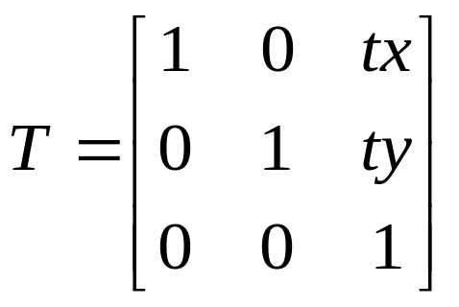
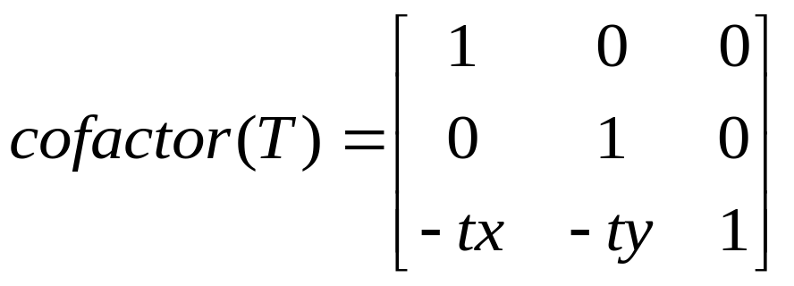




Slide 27








Composite Transformation
Transformations can be combined by matrix multiplication
Efficiency with premultiplication
  Matrix multiplication is associative

Slide 28

Composite Transformation
Translation: 2 successive ~ are applied to point P
ie. Successive translations are additive

Slide 29
Composite Transformation - DIY
Successive Rotation are additive, and
Successive Scaling are multiplicative

Slide 30

Classification of Transformations
Rigid-body Transformation
  Preserves parallelism of lines
  Preserves angle and length
  e.g. any sequence of R(θ) and T(dx,dy)
Affine Transformation
  Preserves parallelism of lines
  Doesn’t preserve angle and length
  e.g. any sequence of R(θ), S(sx,sy) and T(dx,dy)

Slide 31



Classification of Transformations
?
?
?

Slide 32


Properties of rigid-body transformation
The following Matrix is Orthogonal if the upper left 2X2 matrix has the
following properties
A) Each row are unit vector.
  sqrt(r₁₁* r₁₁ + r₁₂* r₁₂) = 1
B) Each column are unit vector.
  sqrt(c₁₁* c₁₁ + c₁₂* c₁₂) = 1
2. A) Rows will be perpendicular to each other
  (r₁₁ , r₁₂ ) . ( r₂₁ , r₂₂) = 0
B) Columns will be perpendicular to each other
  (c₁₁ , c₁₂ ) . (c₂₁ ,c₂₂) = 0
e.g. Rotation matrix is orthogonal
Orthogonal Transformation ⇒ Rigid-Body Transformation
For any orthogonal matrix B ⇒ B⁻¹ = B^{T}

Slide 33


Linear Transformations
Linear transformations are combinations of …
  Scale
  Rotation
  Shear, and
  Mirror
Properties of linear transformations
  Satisfies:
  Origin maps to origin
  Lines map to lines
  Parallel lines remain parallel
  Ratios are preserved
  Closed under composition

Slide 34

Affine Transformations
Affine transformations are combinations of
  Linear transformations, and
  Translations
Properties of affine transformations
  Origin does not map to origin
  Lines map to lines
  Parallel lines remain parallel
  Ratios are preserved
  Closed under composition

Slide 35

Projective Transformations
Projective transformations…
  Affine transformations, and
  Projective warps
Properties of projective transformations
  Origin does not map to origin
  Lines map to lines
  Parallel lines do not necessarily remain parallel
  Ratios are not preserved
  Closed under composition

Slide 36

Commutativity of Transformation Matrices
Matrix multiplication is not commutative
Some non-commutative Compositions:
  Non-uniform scale, Rotate
  Translate, Scale
  Rotate, Translate
7
6
5
4
3
2
1
7
6
5
4
3
2
1
1 | 2 | 3 | 4 | 5 | 6 | 7 | 8 | 9
Scale(0.5,1)
Scale(0.5,1) -> Translate(5,0)
1 | 2 | 3 | 4 | 5 | 6 | 7 | 8 | 9
Scale(0.5,1)
Translate(5,0)->

Slide 37

Commutativity of Transformation Matrices
Matrix multiplication is not commutative
Some non-commutative Compositions:
  Non-uniform scale, Rotate
  Translate, Scale
  Rotate, Translate
Original
Transitional
Final

Slide 38
Commutativity of Transformation Matrices
In general matrix multiplication is not commutative
For the following special cases commutativity holds i.e. M₁.M₂ = M₂.M₁
M₁ | M₂
Translate | Translate
Scale | Scale
Rotate | Rotate
Uniform Scale | Rotate

Slide 39
Associativity of Matrix Multiplication
Create new affine transformations by multiplying sequences of the above basic transformations.
q = CBAp
q = ( (CB) A) p = (C (B A))p = C (B (Ap) ) etc.
matrix multiplication is associative.
To transform just a point, better to do q = C(B(Ap))

Slide 40
Associativity of Matrix Multiplication
But to transform many points, best to do
M = CBA
then do q = Mp for any point p to be rendered.
For geometric pipeline transformation, define M and set it up with the model-view matrix and apply it to any vertex subsequently defined to its setting.

Slide 41
General Pivot point, P(h,k), Rotation of θ : R_{θ,P}
Step 1: Translate P(h,k) to origin
Step 2: Rotate θ w.r.t to origin
Q³(x’’+h, y’’ +k)
Step 3: Translate (0,0) to P(h,k)
P³(h,k)
R_{θ,P}=
T(h ,k) *
R_{θ}*
T(-h ,-k)
Q(x,y)
Q¹(x’,y’)
Q²(x’’,y’’)
P(h,k)
P¹ (0,0)
P² (0,0)

Slide 42

General Pivot point, P(h,k), Rotation of θ : R_{θ,P}

Slide 43

Example
Rotate the point P(4,5) 45° about the point A(1,1)

Slide 44
DIY
Rotate the triangle keeping the center fixed

Slide 45
Fixed point P(h,k) Scaling : S_{sx,sy,p}
Step 1: Translate P(h,k) to origin
Step 2: Scale S(s_{x},s_{y}) w.r.t origin
(7,2)
Step 3: Translate (0,0) to P(h,k)
(1,1)
(7,1)
S_{sx,sy,P}=
T(h ,k) *
S(s_{x},s_{y})*
T(-h ,-k)
T(1,1)
(4,3)
(4,2)
(6,1)
(1,1)
(4,1)
(0,0)
(4,0)
(0,0)
(6,0)
S_{3/2,1/2,(1,1)}
T(-1,-1)
S(3/2,1/2)

Slide 46

Fixed point P(h,k) Scaling : S_{sx,sy,p}
(x_{f},y_{f})
(x_{f},y_{f})
(x_{f},y_{f})
(x_{f},y_{f})
Translate
Scale
Translate

Slide 47






Reflection about line L, M_{L}
Step 1: Translate (0,b) to origin
Step 2: Rotate -θ degrees
Step 3: Mirror reflect about X-axis
Step 4: Rotate θ degrees
Step 5: Translate origin to (0,b)
M_{L} =
T(0 ,b) *
R(θ) *
M _{x}*
R(-θ) *
T(0 ,-b)

Slide 48




Reflection about line L, M_{L}
M_{L} =
T(0 ,b) *
R(θ) *
M _{x}*
R(-θ) *
T(0 ,-b)
$=\left[\begin{matrix}\cos{θ} & −\sin{θ} & 0 \\ \sin{θ} & \cos{θ} & b \\ 0 & 0 & 1\end{matrix}\right]\left[\begin{matrix}\cos{θ} & \sin{θ} & 0 \\ \sin{θ} & −cos{θ} & 0 \\ 0 & 0 & 1\end{matrix}\right]\left[\begin{matrix}1 & 0 & 0 \\ 0 & 1 & −b \\ 0 & 0 & 1\end{matrix}\right]$ $=\left[\begin{matrix}\cos^{2}{θ}−\sin^{2}{θ} & 2\sin{θcos}θ & 0 \\ 2\sin{θcos}θ & −(\cos^{2}{θ}−\sin^{2}{θ}) & b \\ 0 & 0 & 1\end{matrix}\right]\left[\begin{matrix}1 & 0 & 0 \\ 0 & 1 & −b \\ 0 & 0 & 1\end{matrix}\right]$
$$=\frac{1}{1+\tan^{2}θ}\left[\begin{matrix}1−\tan^{2}θ & 2tanθ & 0 \\ 2tanθ & −(1−\tan^{2}θ) & b(1+\tan^{2}θ) \\ 0 & 0 & 1+\tan^{2}θ\end{matrix}\right]\left[\begin{matrix}1 & 0 & 0 \\ 0 & 1 & −b \\ 0 & 0 & 1\end{matrix}\right]$$
$$M_{L}=\frac{1}{m^{2}+1}\left[\begin{matrix}1−m^{2} & 2m & −2bm \\ 2m & m^{2}−1 & 2b \\ 0 & 0 & m^{2}+1\end{matrix}\right]$$

Slide 49



Problem
Show that two successive reflections about any line (two lines) in the xy plane that intersects the coordinate origin
is equivalent to a rotation in the xy plane about the
origin
$$M_{L1}=\left[\begin{matrix}\cos^{2}{θ_{1}}−\sin^{2}{θ_{1}} & 2\sin{θ_{1}cos}θ_{1} & 0 \\ 2\sin{θ_{1}cos}θ_{1} & −(\cos^{2}{θ_{1}}−\sin^{2}{θ_{1}}) & 0 \\ 0 & 0 & 1\end{matrix}\right]$$

Slide 50


Shear – with ref line
Converted to a parallelogram
x’ = x + shx · y, y’ = y
Transformed to a shifted parallelogram
  (Y = Yref)
x’ = x + shx · (y-yref), y’ = y
y
(1,1)
y
(0,1)
(2,1)
(3,1)
(0,0)
x
x
(1,0)
(0,0)
(1,0)
(Shx=2)
y
y
(2,1)
(0,1)
(1,1)
(1,1)
(1/2,0)
x
x
(0,0)
(1,0)
(3/2,0)
(0,-1)
(Shx=1/2, yref=-1)

Slide 51

Shear – with ref line
Transformed to a shifted parallelogram
  (X = Xref)
x’ = x, y’ = shy · (x-xref) + y
(0,3/2)
(1,2)
y
y
(0,1)
(1,1)
(0,1/2)
(1,1)
(0,0)
(1,0)
x
x
(-1,0)
(Shy=1/2, xref=-1)

Slide 52
Problems to be solved:
Schaum’s outline series:
Problems:
4.2
4.3, 4.4, 4.5 => R_{θ,P}
4.6, 4.7, 4.8 => S_{sx,sy,,P}
4.9, 4.10, 4.11, 4.21 => M_{L}
4.12 => Shearing
4.29, 4.34

